Slide 1

Study of the compatibility of 3D-printed loads with a space environment
6th SPACE PASSIVE COMPONENT DAYS - SPCD 2026
ESA/ESTEC
Lab-STICC:
Lana Damaj
Azar Maalouf
Jessica Benedicto
Alexis Chevalier
Vincent Laur
Thales Alenia Space:
Juan-Antonio Duran Venegas
Yann Cailloce
Centre National d’Etudes Spatiales (CNES):
Kevin Elis

Slide 2
Outline
Introduction
Technology and materials
Experimental validation :low power and room temperature
Experimental validation in space-like environment
Conclusion

Slide 3
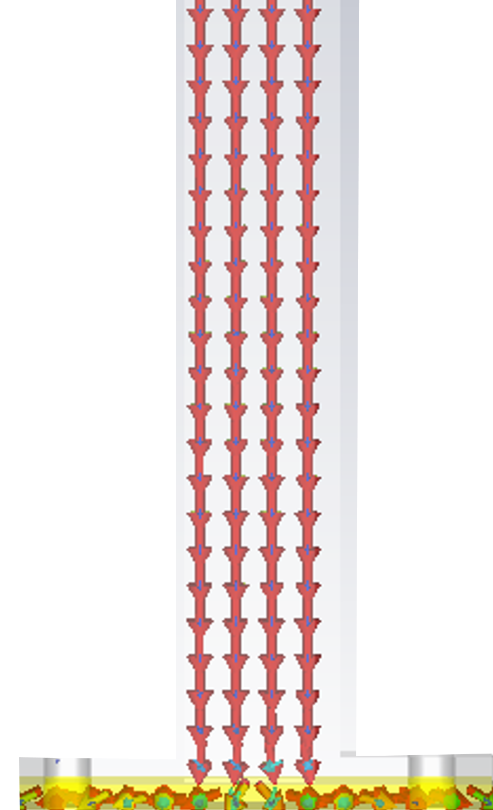
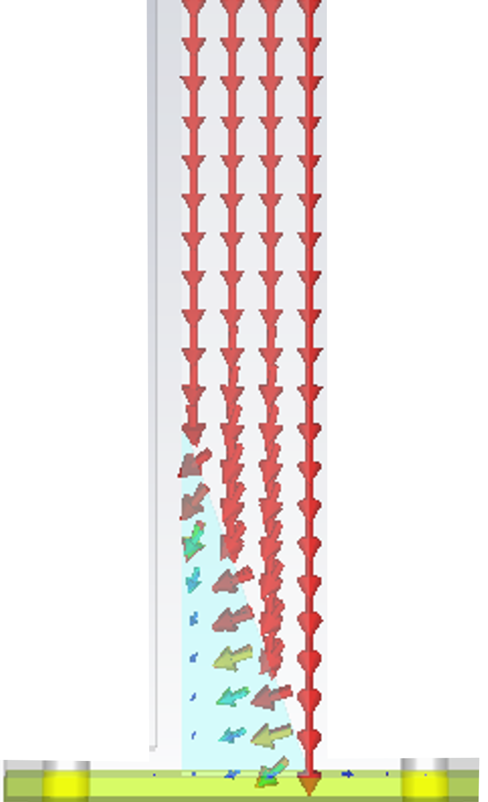
Introduction
Matched termination (load) in waveguide
  Prevent reflections and improve signal quality.
  Used in microwave and RF architectures
Typical Design:
  Short-circuited waveguide filled with lossy absorbing material
  Increases system size and weight
Emerging Solution: 3D-printing terminations.
  Benefits: Enables complex geometries; reduces weight and size.
  Key Considerations: Absorption, Power Handling Capability (PHC), and cost-effectiveness
Without load
With load

Slide 4
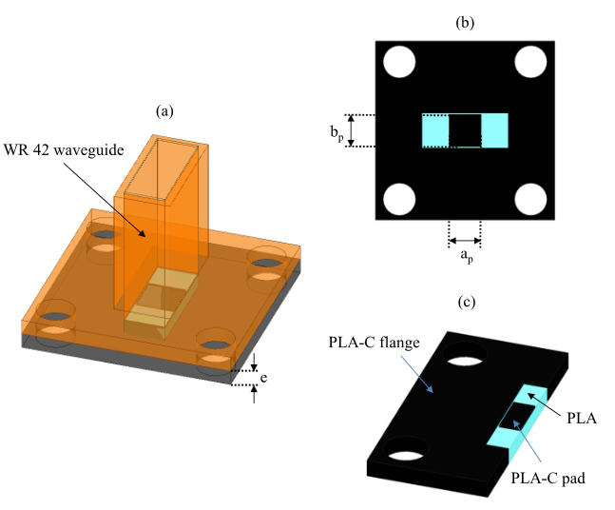
3D-Printing termination for Space applications
Fused deposition modelling (FDM)
  FDM offers great design freedom
  Enables graded, tapered and multi-material absorbers
Limitation
  Standard thermoplastics don't meet the thermal and mechanical requirements of space
Key challenge
  Develop space-compatible printable materials for additively manufactured microwave components
Multi-material waveguide termination

Slide 5
Candidate materials
Loads with high power handling capability
  Thermoplastic composites with high melting temperature
  High dielectric losses are required
Material selected: Ice9, PEKK-ESD et PEEK-ESD
Material | From | Thermal conductivity (W.m⁻¹.K⁻¹) | Glass transition temperature (T_{g} °C) | Melting point (T_{m} °C) | Resistivity Ω.m
Ice9 | TCPoly | 3 | - | - | -
PEKK-ESD | 3DXTECH | 0.25 | 162 | 305 | 107 to 109
PEEK-ESD | 3DXTECH | 0.25 | 143 | 343 | 107 to 109
Comparison of material properties

Slide 6
Materials Properties characterization
Various methods employed to determine dielectric properties of materials:
  Rectangular waveguides in bands: X (8-12 GHz) and Ku (12-18 GHz)
  Coaxial line measurements APC7: 0.05-18 GHz
Sample Fabrication: toroidal and parallelepiped samples created by 3D printing
Determination of Complex Permittivity:ε′−jε′′
Material | Permittivity | Loss tangent
Ice9 | 13.8 | 0.08
PEKK-ESD | 7.6 | 0.12
PEEK-ESD | 10.4 | 0.3
Comparison of dielectric characteristics of materials in ku-band

Slide 7
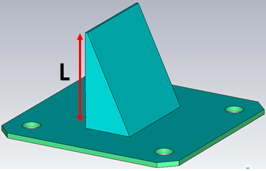
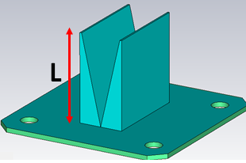
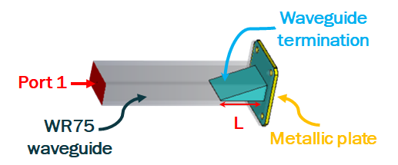
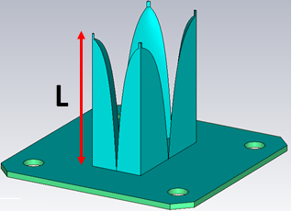
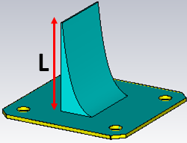
Shape and materials effects on load performances
Structures (wedges) | Materials | Length L (mm) | PLD (W/m³) *10⁵ | Volume (mm³)
 | Ice9 | 41 | 9.08 | 5267
 | PEEK-ESD | 19 | 40.39 | 3187
 | PEKK-ESD | 32 | 10.82 | 4417
 | Ice9 | 45 | 11.98 | 5817
 | PEEK-ESD | 19 | 14.17 | 3260
 | PEKK-ESD | 58 | 6.31 | 7095
 | Ice9 | 33 | 14.85 | 3202
 | PEEK-ESD | 23 | 14.15 | 2618
 | PEKK-ESD | 70 | 6.72 | 5616
 | Ice9 | 59 | 26.08 | 4172
 | PEEK-ESD | 25 | 44.09 | 2742
 | PEKK-ESD | 59 | 14.37 | 4172
Characterization conducted in the Ku-band (10.7 GHz to 13.75 GHz).
Load lengths ‘L’ optimized in CST to achieve a reflection level of less than -20 dB.

Slide 8
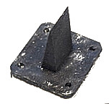
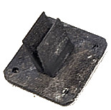
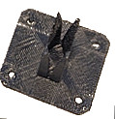
Shape and materials effects on load performances
Structures (wedges) | Materials | Length L (mm) | PLD (W/m³) *10⁵ | Volume (mm³)
 | Ice9 | 41 | 9.08 | 5267
 | PEEK-ESD | 19 | 40.39 | 3187
 | PEKK-ESD | 32 | 10.82 | 4417
 | Ice9 | 45 | 11.98 | 5817
 | PEEK-ESD | 19 | 14.17 | 3260
 | PEKK-ESD | 58 | 6.31 | 7095
 | Ice9 | 33 | 14.85 | 3202
 | PEEK-ESD | 23 | 14.15 | 2618
 | PEKK-ESD | 70 | 6.72 | 5616
 | Ice9 | 59 | 26.08 | 4172
 | PEEK-ESD | 25 | 44.09 | 2742
 | PEKK-ESD | 59 | 14.37 | 4172
Three loads were selected : single , double and tetrahedral wedge
1.22 to 2.18 times greater volumes with Ice9 and PEKK-ESD compared to PEEK-ESD.
(a)
(b)
(c)
3D-printing waveguide terminations (a) single linear wedge, (b) double linear wedge and (c) tetrahedral exponential wedge

Slide 9
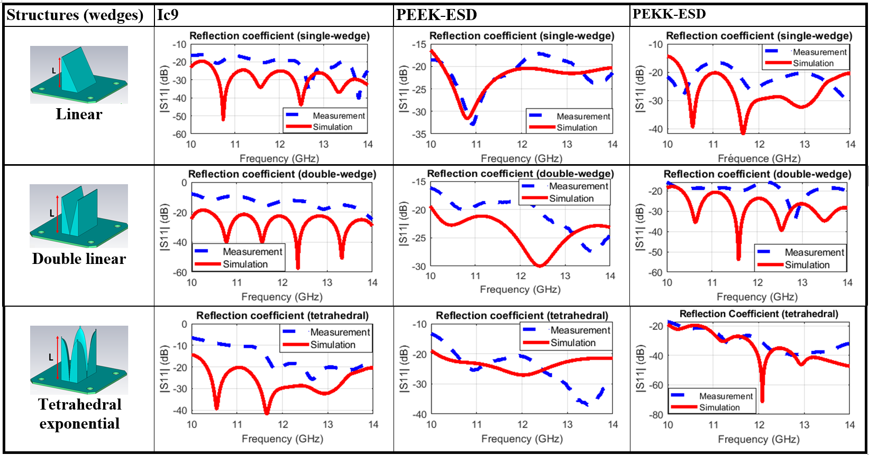
Simulated and measured reflection coefficients
Significant discrepancy between simulated and measured reflection levels for Ice9.
Exponential tetrahedral wedge: Handling difficulties encountered
Measured reflection slightly higher than simulated
Designs slightly optimized to compensate
Target: measured reflection below −20 dB over the frequency band

Slide 10
Simulated and measured reflection coefficients
Significant discrepancy between simulated and measured reflection levels for Ice9.
Exponential tetrahedral wedge: Handling difficulties encountered
Measured reflection slightly higher than simulated
Designs slightly optimized to compensate
Target: measured reflection below −20 dB over the frequency band
Single- and double-linear wedge loads in PEEK-ESD selected for:
Power-handling experiments
Experimental validation in a space-like environment

Slide 11
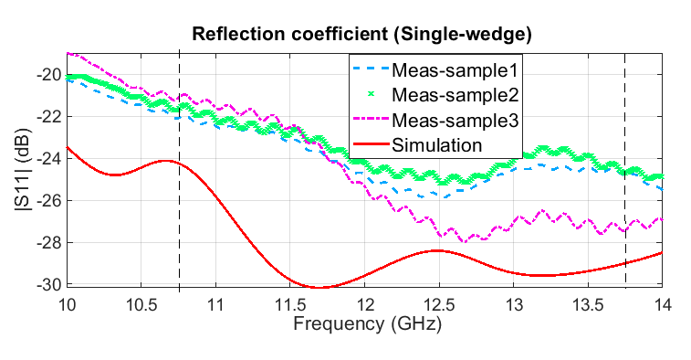
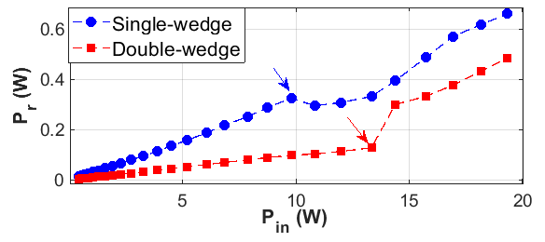

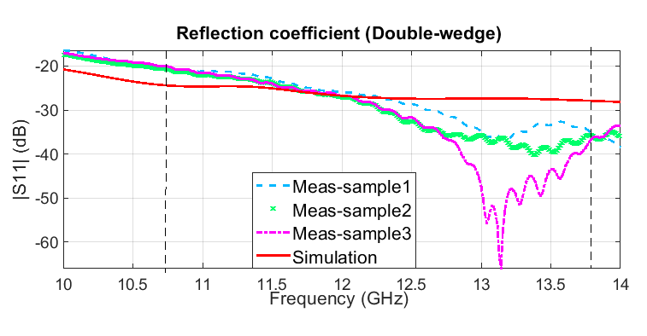

Measured performances at room temperature
Measurements of reflected power with respect to the incident power
Good agreement between simulated and measured reflection coefficients
Power-handling capability of the two selected loads evaluated at 11 GHz
The double-linear wedge shows a higher power-handling capability than the single-linear wedge
Simulated and measured reflection coefficient for single and double linear wedges

Slide 12

Space-like environment testing
Space-like test conditions
  Thermal vacuum chamber simulating representative space environmental conditions
  Volume: 2 m³
  Temperature range: −150 °C to +150 °C (accuracy ±1.5 °C)
  Pressure: kept below 5×10⁻⁵ mbar during the tests

Slide 13
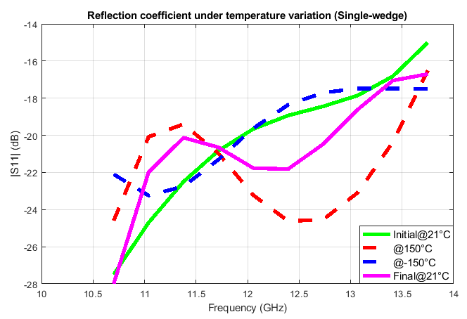
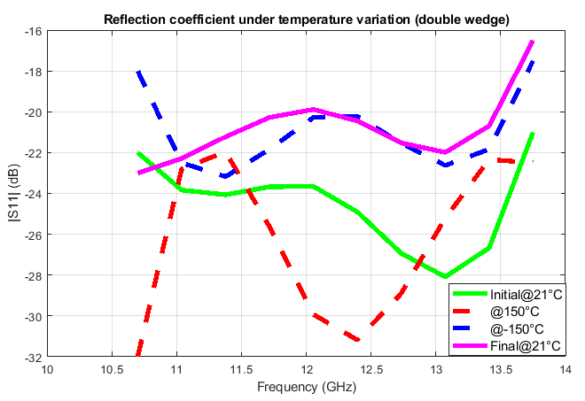
Space-like environment testing: vacuum and thermal
Reflection coefficient stays acceptable over the entire temperature range
Double-linear wedge: below −20 dB over most of the operating band
No significant degradation of the load's electromagnetic performance (|S₁₁|<-15dB)

Slide 14
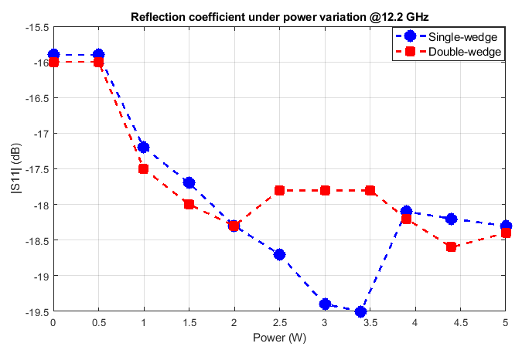
Space-like environment testing: power
Power-handling test conditions
  Frequency: 12.2 GHz
  Incident power: 0 to 5 W, in 0.5 W steps
  Thermal vacuum chamber temperature: constant at +150 °C
The reflection coefficient remains relatively stable, varying by about 3.5 dB (single wedge) and 2.5 dB (double wedge).
Good electromagnetic stability under high-temperature vacuum, up to 5 W incident power.
Measured reflection coefficient for single- and double-wedge under power variation at 12.2 GHz

Slide 15
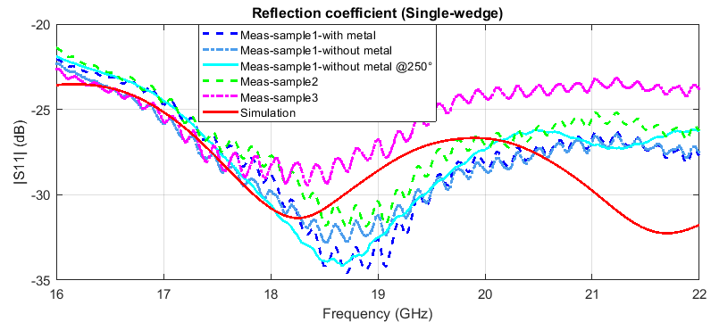
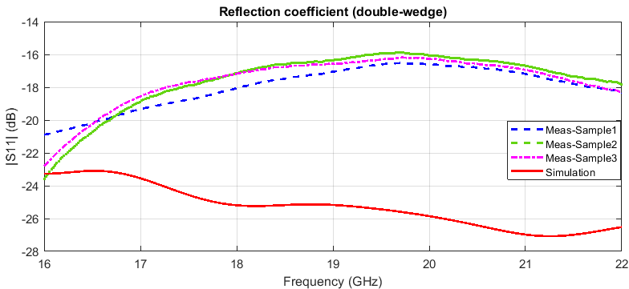
Extending the study to the Ka-band
Single- and double-linear wedge loads redesigned for the Ka-band (17.3–21.2 GHz): loads length of 20 mm.
Simulated and measured reflection coefficients
Single-linear wedge: excellent agreement between simulated and measured reflection over the entire band
Double-linear wedge: significant simulation–measurement discrepancy, due to its small dimensions, which make accurate manufacturing difficult

Slide 16
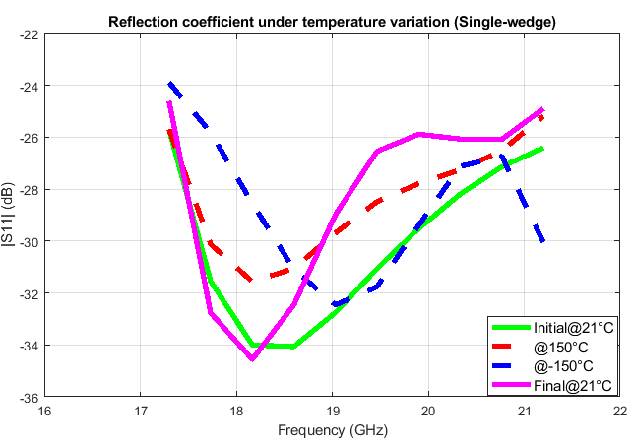
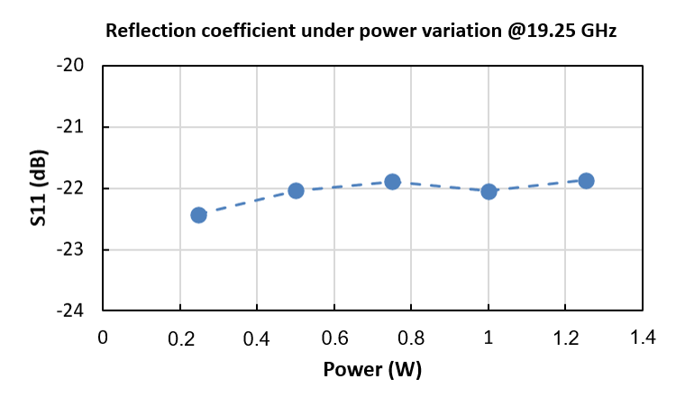
Extending the study to the Ka-band
Space-like environment testing: vacuum and thermal testing
No significant degradation in |S₁₁| regardless of temperature
High-power tests at 19.25 GHz (pressure below 5×10⁻⁵ mbar, +150 °C)
Incident power limited to 1.25 W (application requirement): reflection coefficient stable, varying by only 0.6 dB

Slide 17
Conclusion
High-temperature thermoplastic composites investigated for space-compatible rectangular waveguide loads
PEEK-ESD loads showed promising performance for space applications in both the Ku- and Ka-bands
Good simulation–measurement agreement, confirming the design approach and the reproducibility of the manufacturing process
Stable electromagnetic performance under vacuum and thermal cycling, but power limitations identified
Ka-band single wedge: reflection below −20 dB during high-temperature vacuum power tests, with limited variation and no significant degradation afterwards
Thank you for your attention

Slide 18
Questions slides

Slide 19
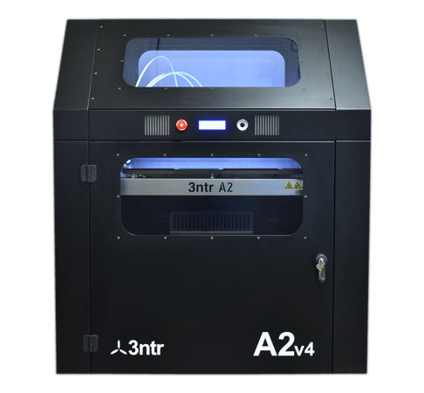
3D- printing
Main settings
Print nozzle diameter | 0.4 mm
Nozzle temperature | 390 °C
Bed temperature | 110 °C
Chamber temperature | 75 °C
Layer thickness | 0.2 mm
Print speed | 30 mm.s⁻¹
Fill rate | 100 %
High-temperature printing (390°C) on a 3NTR A2v4 machine ABS support material, followed by dissolution in acetone

Slide 20
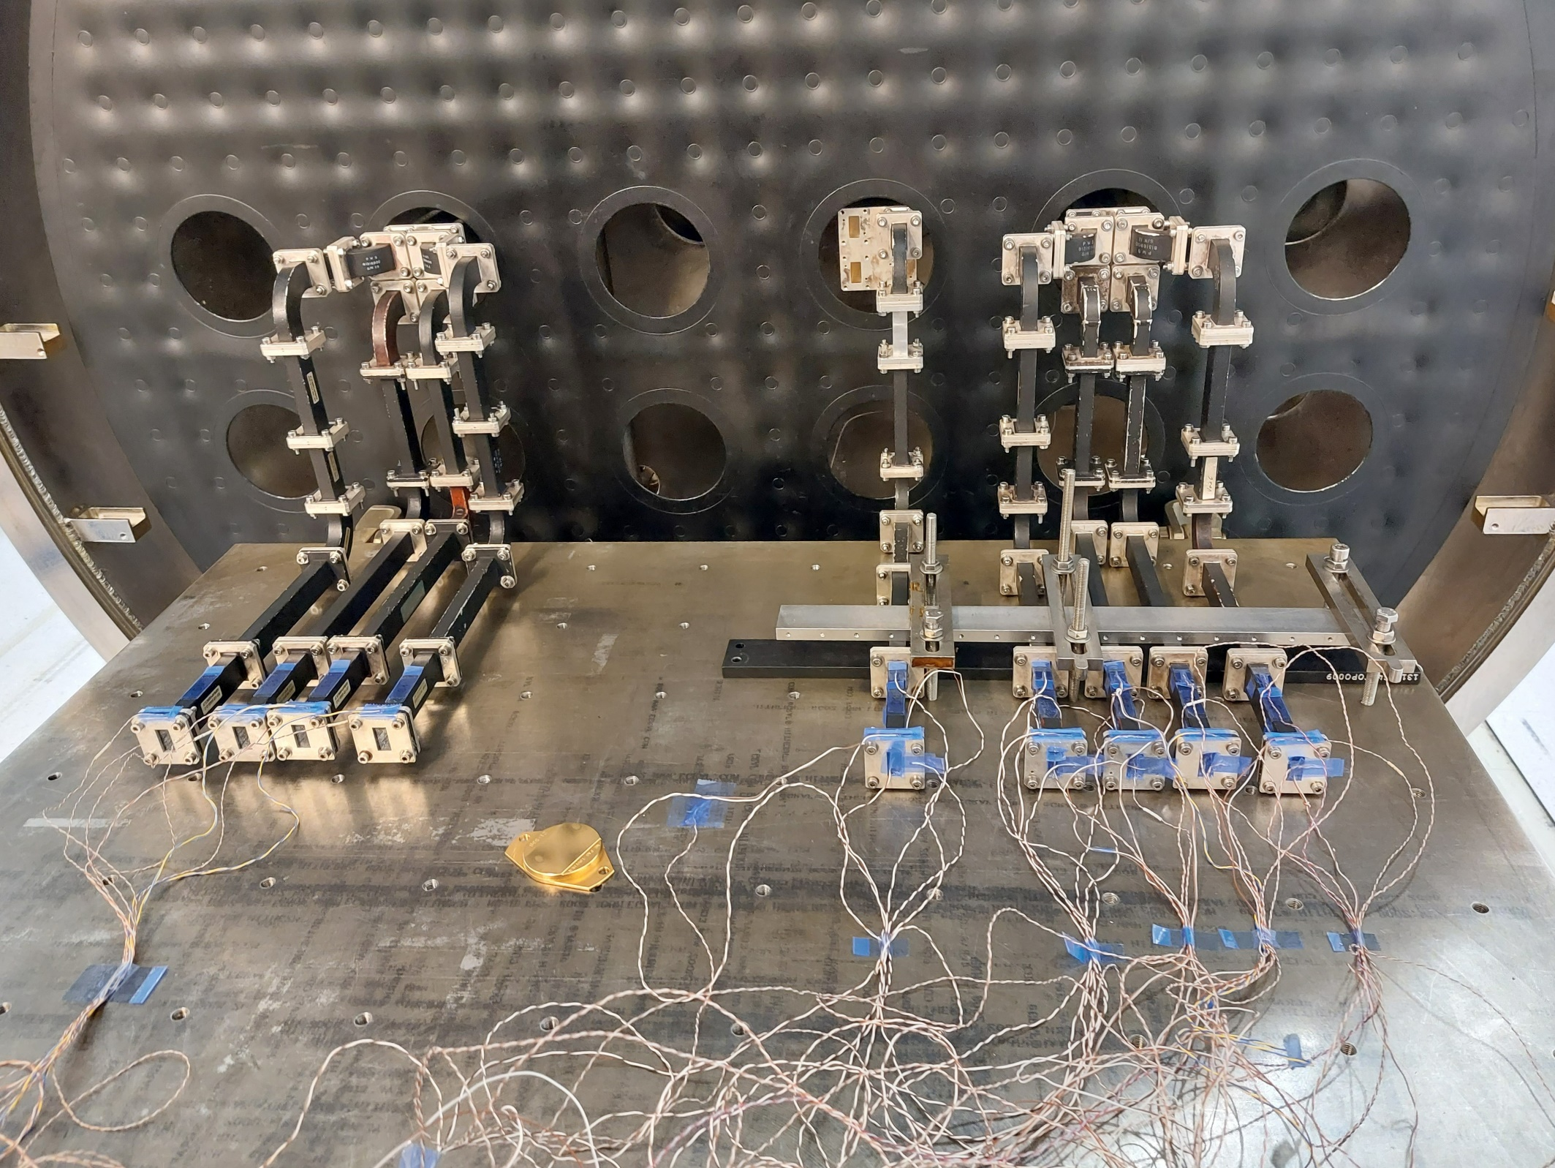
Space-like environment testing
Space-like test conditions
  Thermal vacuum chamber reproducing representative space environmental conditions
  Volume: 2 m³
  Temperature range: −150 °C to +150 °C (accuracy ±1.5 °C)
  Pressure: kept below 5×10⁻⁵ mbar during the tests

Slide 21
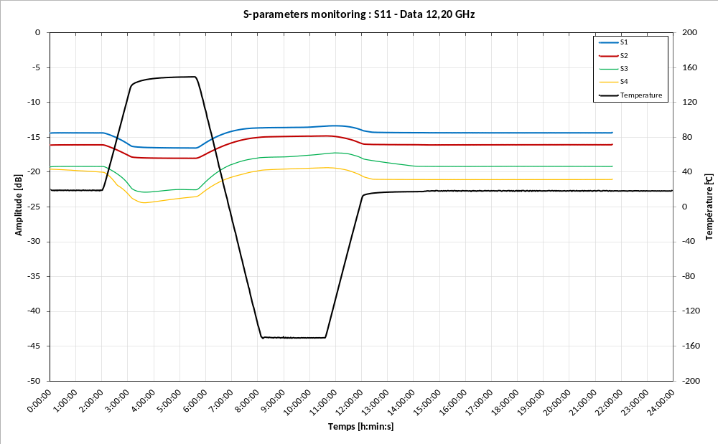
TAS measurements
The temperature ramp rate was maintained below 2°C/min

Slide 22
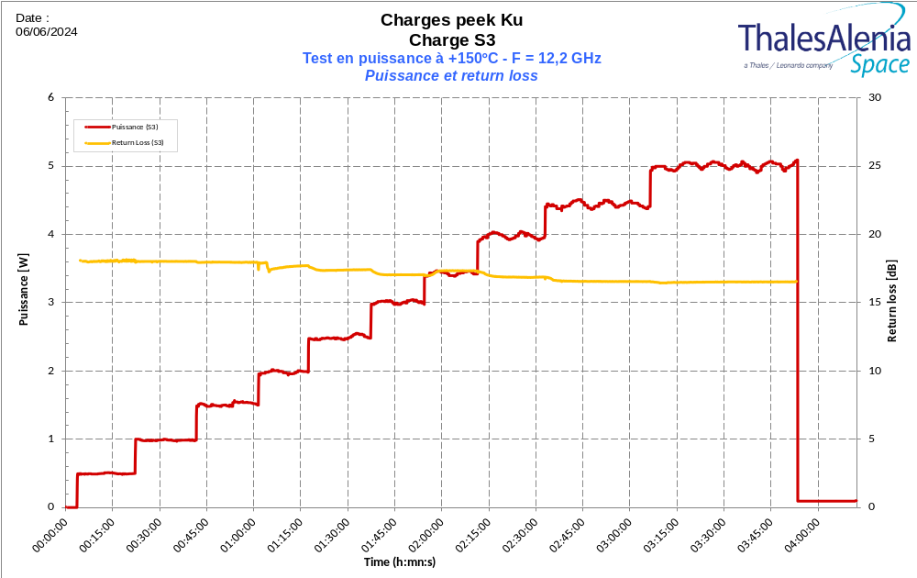
TAS measurements

